Slide 1
Sorting
Jiexin Wang
School of Software Engineering
South China University of Technology

Slide 2
Lower Bound for Sorting

Slide 3
A General Lower Bound for Sorting
The problem of sorting is bounded by Ω(N) and O(N logN).
  A sorting problem cannot be solved by any algorithm in less than Ω(N) time
  Current best known sorting algorithm is in O(NlogN) (for average and worst cases)
One of the most important and most useful proofs in computer science
No sorting algorithm based on key comparisons can possibly be faster than Ω(N logN) in the worst case.

Slide 4
Decision Tree
Assume that all N elements are distinct
Any sorting algorithm based on comparisons can be modeled by a decision tree.
A decision tree is a binary tree that can model the processing for any algorithm that makes binary decisions.
  Binary decision: yes or no; smaller than or larger than
  Each decision is represented by a branch in the tree

Slide 5
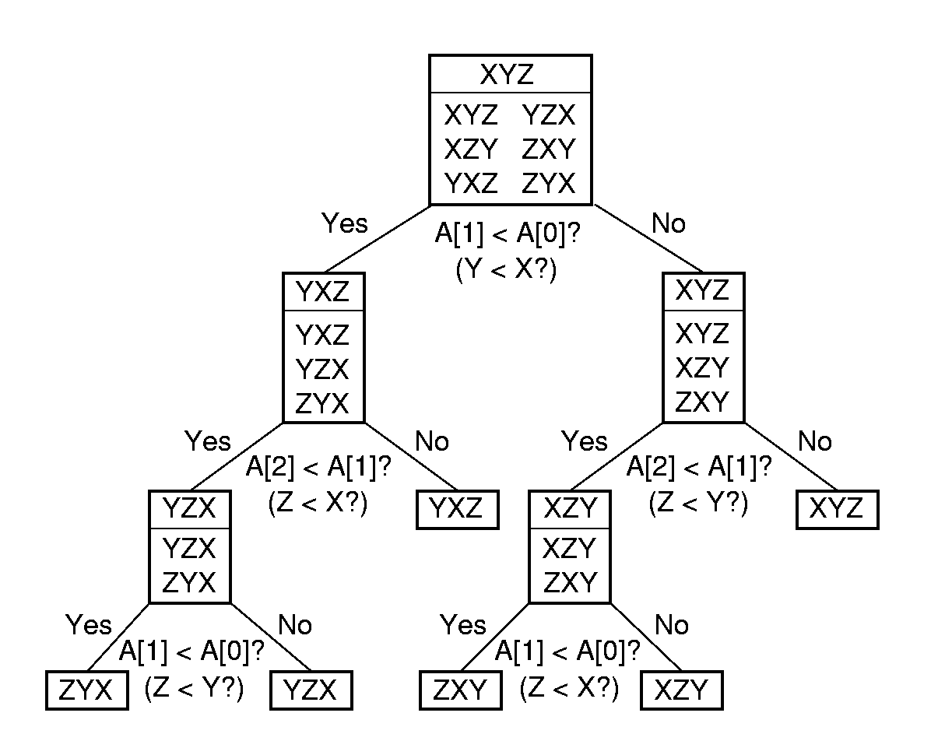
Decision-Tree
The initial state of the algorithm(root)
The results of the comparison
Each node represents a set of possible orderings
Decision tree for Insertion Sort of array A=[X, Y, Z]

Slide 6
Decision-Tree
All sorting algorithms can be viewed as algorithms to “find” the correct permutation of the input that yields a sorting list.
  Proceed by making branches in the tree based on the results of key comparisons
  The algorithm can terminate once a node with a single permutation has been reached (leaf).
The depth of the deepest node represents the longest series of decisions required by the algorithm to reach an answer
  It corresponds to the worst-case cost of the algorithm!

Slide 7

Binary tree properties
A binary tree of depth d has at most 2^{d} leaves.
A binary tree with L leaves must have depth at least $\left\lceil log⁡L\right\rceil$.

Slide 8
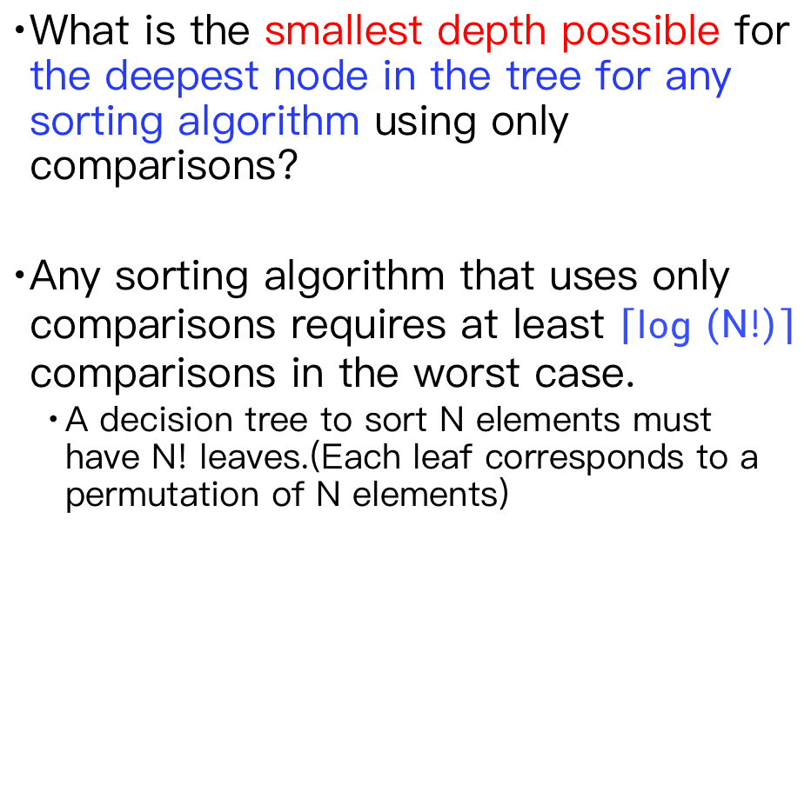
A General Lower Bound for Sorting
What is the smallest depth possible for the deepest node in the tree for any sorting algorithm using only comparisons?
Any sorting algorithm that uses only comparisons requires at least $\left\lceil log⁡\left(N!\right)\right\rceil$ comparisons in the worst case.
  A decision tree to sort N elements must have N! leaves.(Each leaf corresponds to a permutation of N elements)

Slide 9
A General Lower Bound for Sorting
Any sorting algorithm that uses only comparisons between elements requires Ω (N logN) comparisons.
log⁡(N!) = log(N(N − 1)(N − 2) · · · (2)(1))
= logN + log(N − 1) + · · ·+log 2 + log 1
≥ logN + log(N − 1) · · ·+log(N/2)
≥ (N/2) log(N/2)
≥ (N/2) logN – (N/2)
= Ω (N logN)

Slide 10
Decision-Tree Lower Bounds for Selection
Problems
Selection Problems
  find the smallest item in an N-element collection
  find the two smallest items in an N-element collection
  find the median
The lower bounds of these problems solved by comparison-based algorithms can be determined using decision trees.

Slide 11
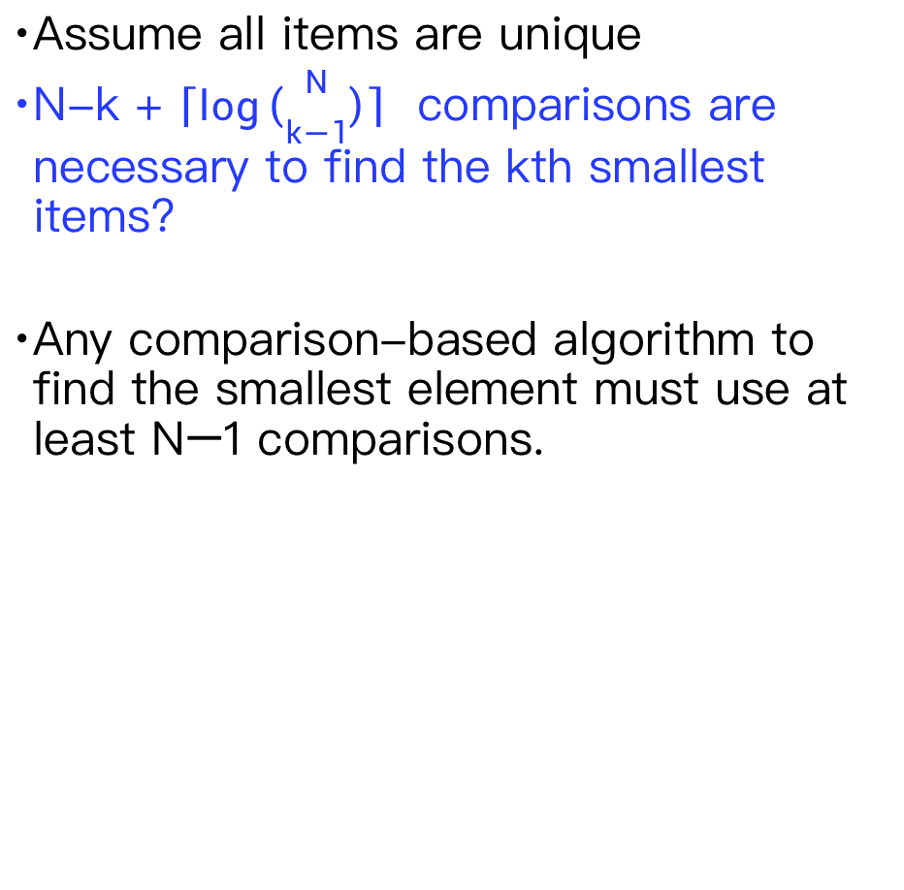
Decision-Tree Lower Bounds for Selection
Problems
Assume all items are unique
N-k + $\left\lceil log\left({N \atop k−1}\right)\right\rceil$ comparisons are necessary to find the kth smallest items?
Any comparison-based algorithm to find the smallest element must use at least N−1 comparisons.

Slide 12
Decision-Tree Lower Bounds for Selection
Problems
If all the leaves in a decision tree are at depth d or higher, the decision tree must have at least 2^{d} leaves.
  A decision tree is a binary tree
  A binary tree with depth d must have at most 2^{d} leaves.
  Here, all non-leaf nodes have two children.
The decision tree for finding the smallest of N elements must have at least 2^{N−1} leaves.
  All leaves in this decision tree are at depth N − 1 or higher

Slide 13
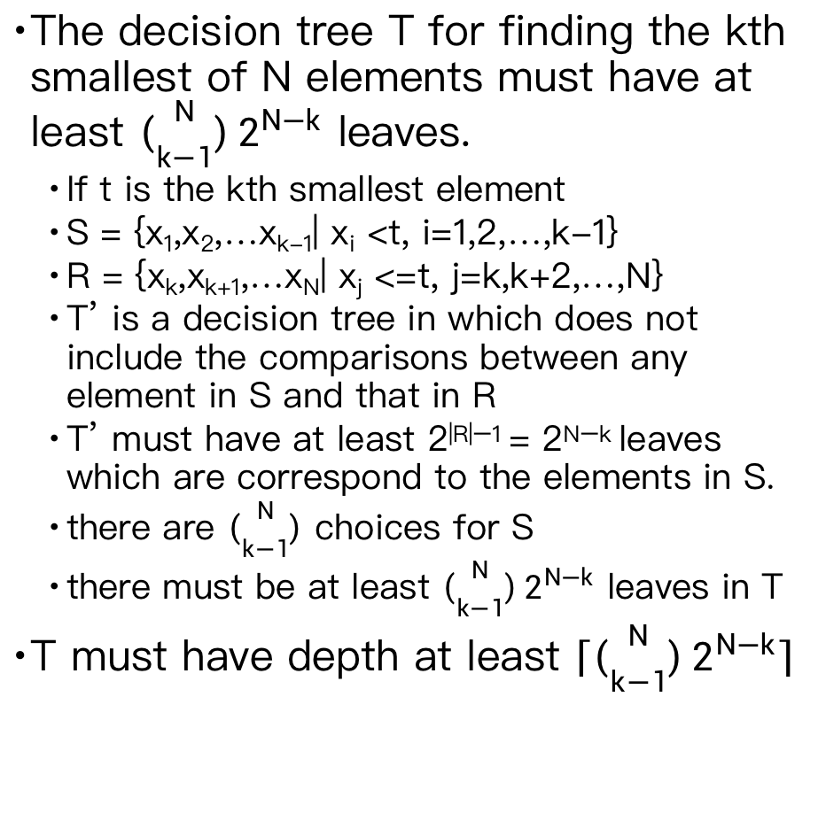
Decision-Tree Lower Bounds for Selection
Problems
The decision tree T for finding the kth smallest of N elements must have at least $\left({N \atop k−1}\right)2^{N−k}$ leaves.
  If t is the kth smallest element
  S = {x₁,x₂,…x_{k-1}| x_{i} <t, i=1,2,…,k-1}
  R = {x_{k},x_{k+1},…x_{N}| x_{j} <=t, j=k,k+2,…,N}
  T’ is a decision tree in which does not include the comparisons between any element in S and that in R
  T’ must have at least 2^{|R|−1} = 2^{N−k} leaves which are correspond to the elements in S.
  there are $\left({N \atop k−1}\right)$ choices for S
  there must be at least $\left({N \atop k−1}\right)2^{N−k}$ leaves in T
T must have depth at least $\left\lceil \left({N \atop k−1}\right)2^{N−k}\right\rceil$

Slide 14
Homework 5-4
Self study 7.10 Adversary augment for lower bounds

